Slide 1
(1)
Pastor Gary Hart October 25, 2015
Text: From that time on Jesus began to preach, “Repent, for the kingdom of heaven has come near.” (Mt.4:17). “The time has come,” he said, “The kingdom of God has come near. Repent and believe the good news!” (Mk.1:15) “But he said, “I must proclaim the good news of the kingdom of God to the other towns also, because that is why I was sent.” (Lk.4:43)
Title: “Thy kingdom come.” (Lord’s Prayer-3)
In the Lord’s Prayer there are 4 requests about God(on earth and in heaven),4 requests about us.

Slide 2
3rd message in a series on the Lord’s Prayer.
(2)
a. Teaching disciples’ prayer. What is prayer?
b. Prayer is calling on God’s name (relationship).
1). Jehovah God (Gen.4:26).
2). Almighty God (Gen. 17:1; 35:11).
3). Heavenly Father (Mt. 6:9).
4). Abba Father (Gal.4:.6)
c. Prayer is seeing God is greater than our problems.
d. Prayer is seeking God’s mission (Mt.6:10).
Jesus had a mission for coming and He left a mission for His followers. Thy kingdom come.

Slide 3
1. What is the Kingdom? It is not… It is…
a. “Kingdom” occurs in the OT as the rule of human kingdoms—Israel, Judah and other nations (Babylon, Persian, Greek, Roman, etc.
also Sinim/Sino/China--Isa.49:12).
b. “Kingdom” occurs in the NT as the rule of God’s Kingdom—50 times in Matthew (33 times as “kingdom of heaven” and 4 times as “kingdom of God”) also in Mark and Luke.
c. “Kingdom of God/Heaven” is the reign of God that he brings about through Jesus Christ.
(3)

Slide 4
(4)
2. Who is the King? He is not… He is…
a. “King” occurs in the Bible as human kings—
b. “King” occurs in the Bible as God—The King of heaven(Da.4:37), The King of glory (Ps.24:10), The eternal, immortal, invisible King (1T.1:17), The great King (Ps.47:2), He rules over all the earth (Ps.99:1-2), and He rules from His throne (Ps.9:4,7-8).
c. “King” occurs in the Bible as Christ—prophesied in OT (Isa.9:6-7), fulfilled in the NT “Where is the one who has been born king of the Jews?(Mt.2:2). King of Kings(Rev.17:14;19:16).

Slide 5
(5)
3. Who are the Subjects of the King?
a. Human Kings rule over their countries.
b. Divine King (God) rules over the earth. Christ’s 2nd coming: They…reigned with Christ a thousand years(Millennial Kingdom-Rev.20:4)
c. Divine King (Christ) rules in the hearts and lives of his people. Jesus replied, “The coming of the kingdom of God is not something that can be observed, nor will people say, ‘Here it is,’ or ‘There it is,’ because the kingdom of God is in your midst.” (Lk.17:20-21). Comes through Christ’s life, death and resurrection.

Slide 6
(6)
4. How can one enter the Kingdom of God?
a.By being born again(experience the new birth). Jesus replied, “Very truly I tell you,no one can see the kingdom of God unless they are born again.” (Jn.3:3).
b. By repenting of their sins. “The time has come,” he said. “The kingdom of God has come near. Repent and believe the good news!” (Mk.1:15).
c. By persevering in the faith. Strengthening the disciples and encouraging them to remain true to the faith. “We must go through many hardships to enter the kingdom of God,” they said. (Ac.14:22)
d. By doing the will of God. “Not everyone who says to me, ‘Lord, Lord,’ will enter the kingdom of heaven, but only the one who does the will of my Father who is in heaven.
(Mt.7:21-23).

Slide 7
5. Who proclaims the Kingdom of God?
(7)
a. The message of John. Repent, for the kingdom of heaven has come near.” (Mt.3:2).
b.The message of Jesus(Mt.4:23;Mk.1:15;Lk.4:43).
c. The message of the apostles. He witnessed to them from morning till evening, explaining about the kingdom of God, and from the Law of Moses and from the Prophets he tried to persuade them about Jesus. (Ac.28:23)
d. The message of all believers (Mt.28:19-20; Mk.16:15;Lk.24:46-48;Jn.20:21;Ac.1:8). The Great Commission is our Great “Thy Kingdom come” Mission to proclaim and pray for God’s Kingdom to come to the hearts of others.

Slide 8
Conclusion:
(8)
May God reign as King on the throne of my heart. May God’s Kingdom come more and more completely in our lives and in our church. We must pray for our mission and the mission of our church. The mission is the heart of God. Praying for God’s kingdom to come is praying after God’s own heart. Let us seek and pray for God’s Mission. Let us pray together, “Our Father…”

Slide 9
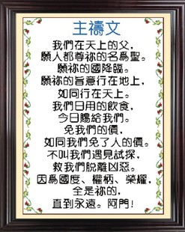
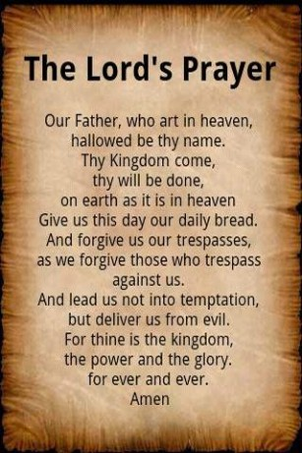
(9)

