Slide 1
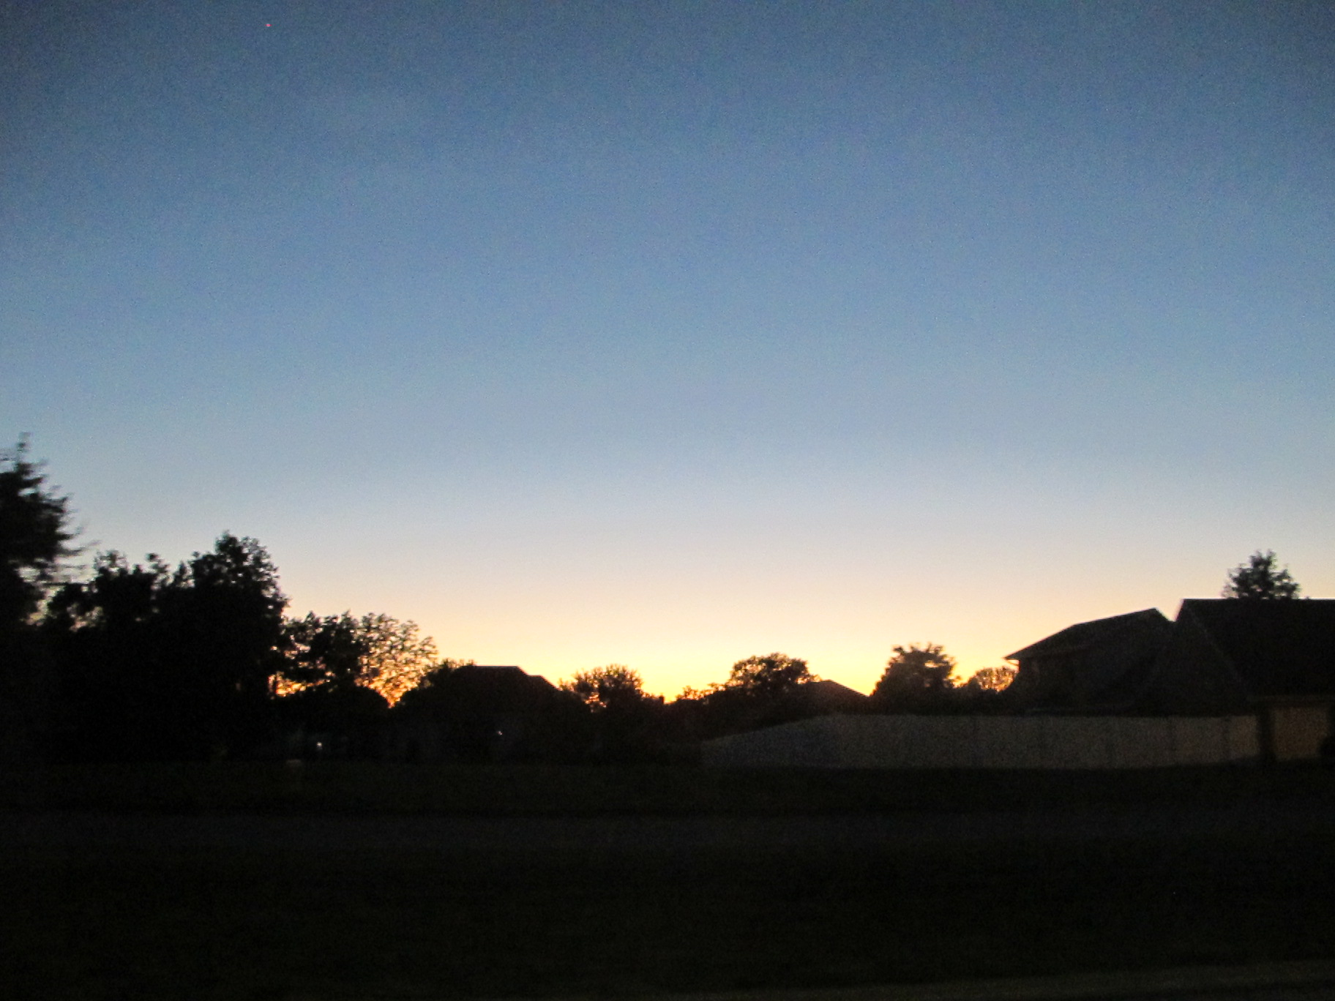
The Gospel Life
Philippians 4:1-7

Slide 2
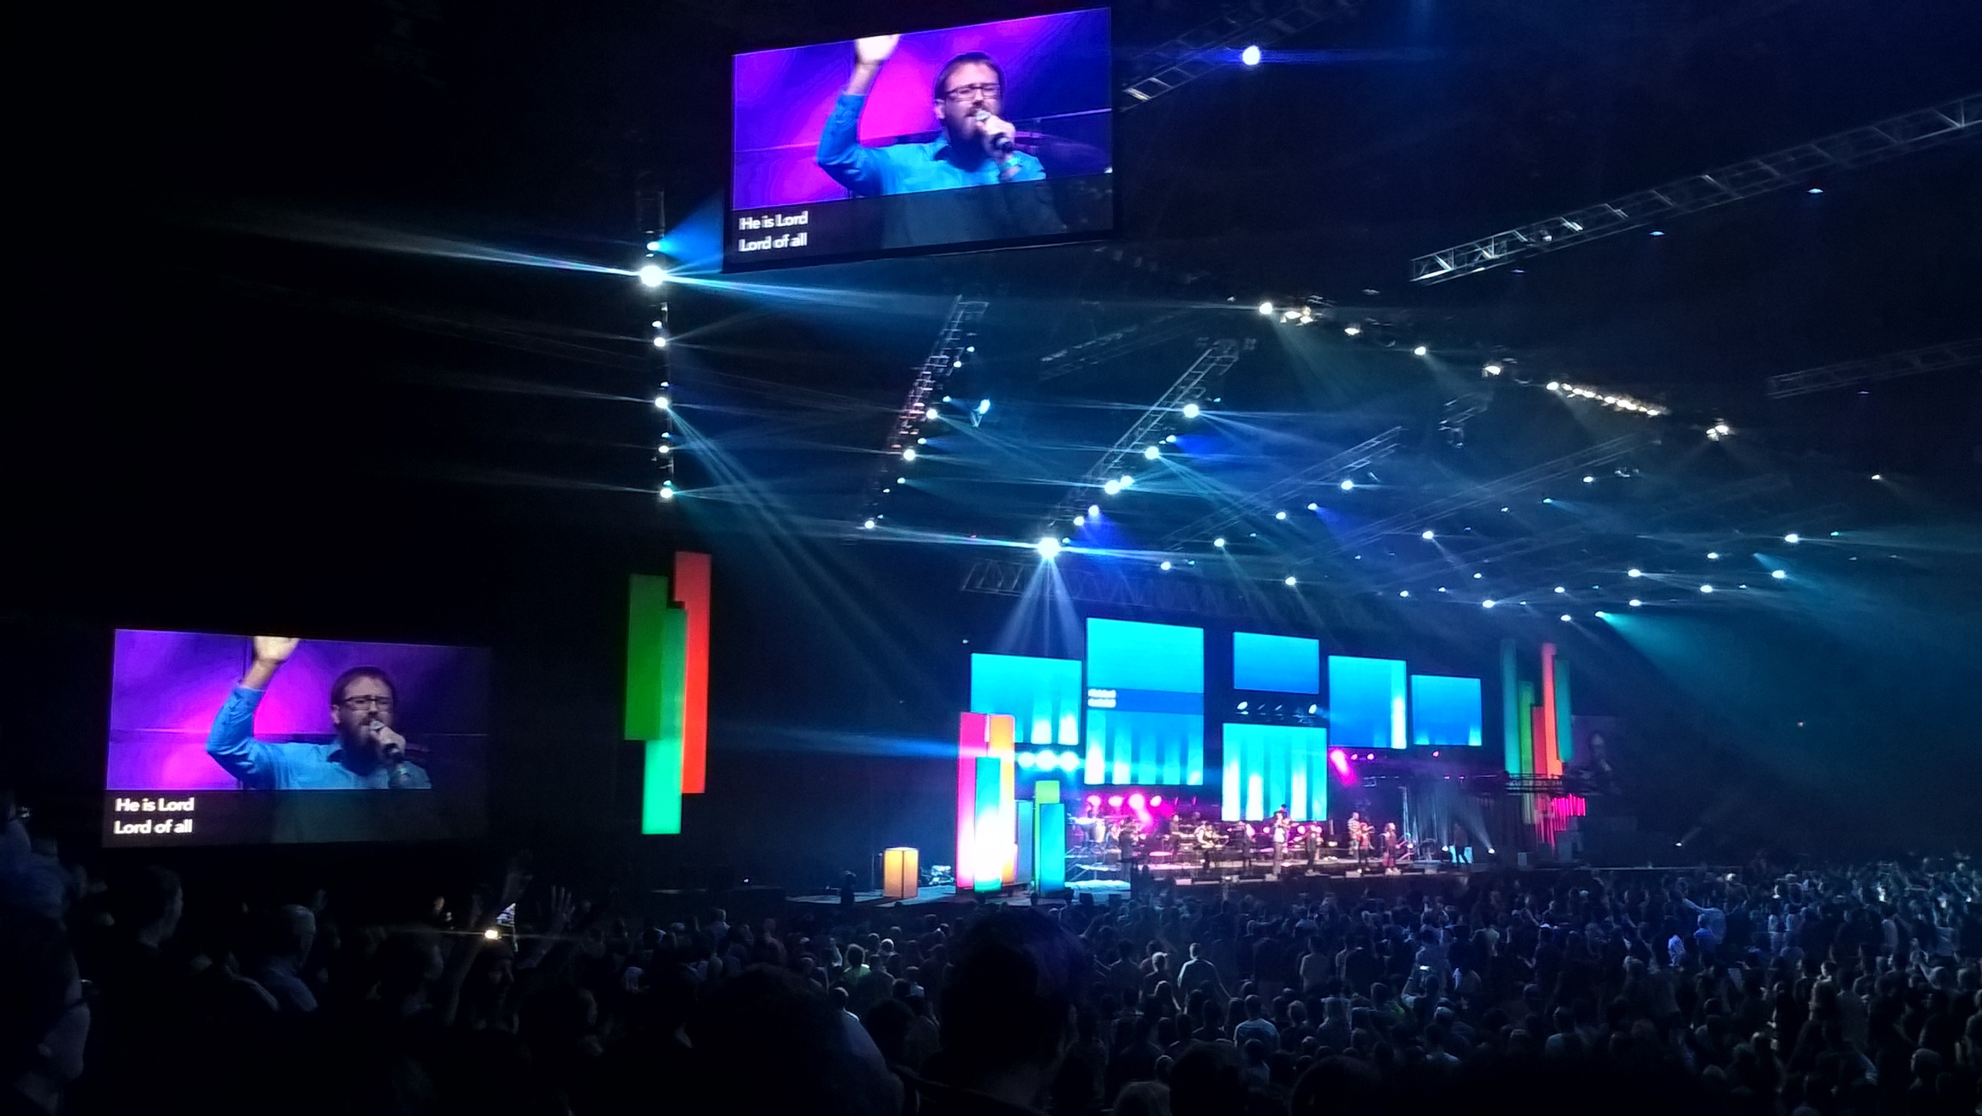

Slide 3
Philippians 3:14
I press on toward the goal to win the prize for which God has called me heavenward in Christ Jesus.
Who was Paul’s prize?

Slide 4
Believers proclaim the gospel to the world through
Two Complementary Lifestyles
Philippians 4:1-7

Slide 5
A Lifestyle of
Inward Christian Unity
Philippians 4:1-3

Slide 6

Avengers?

Slide 7
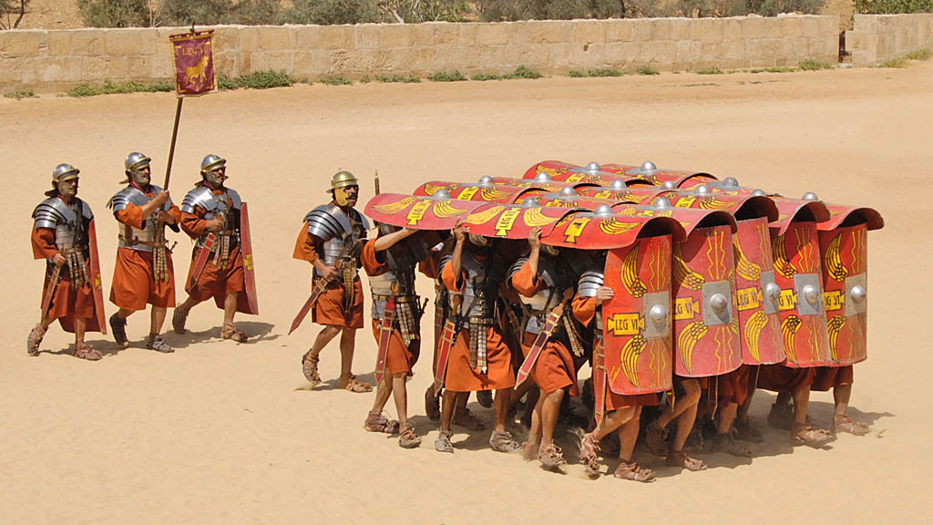
Testudo (Tortoise) Formation

Slide 8
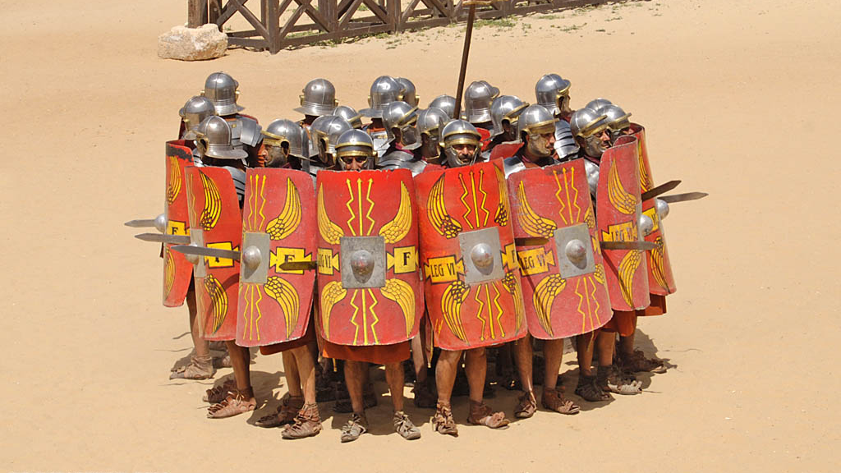
Orbis (Circle) Formation

Slide 9
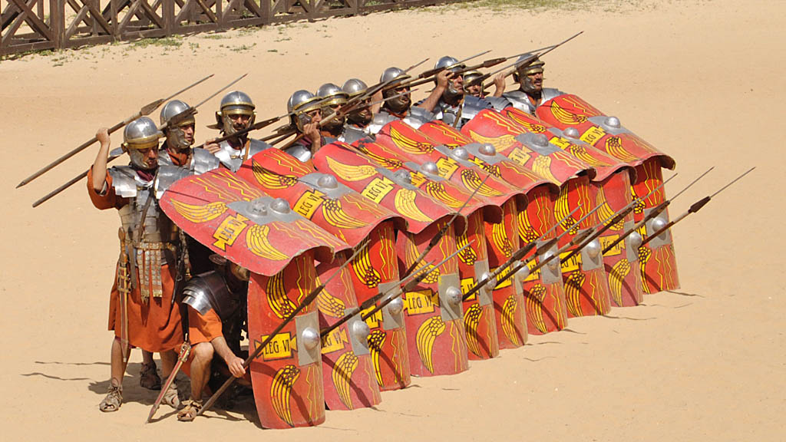
Repellere Equites (Anti-Calvary) Formation

Slide 10
A Lifestyle of Inward Christian Unity
Reconcile broken relationships with one another (verse 2)
  Euodia and Syntyche
  Not doctrinal error or moral failure, but personal problems
Intercede to help mend broken relationships between others (verse 3)
  Paul didn’t command Euodia and Syntyche to get along!
  Done with humility and gentleness
  Pray for them? Listen to both side? Neutral Arbiter?

Slide 11
A Lifestyle of
Outward Christian Joy
Philippians 4:4-7

Slide 12
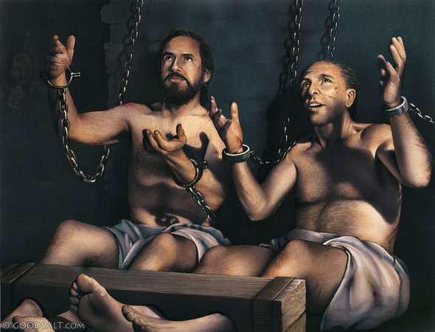

A Lifestyle of Outward Christian Joy
Paul in Prison
Us Pulled Over???

Slide 13
What makes the Good News so “good?”
Jesus’s died for our sins?
The Holy Spirit dwells in us?
The Father recognizes us as sons and daughters?
JESUS IS COMING BACK FOR US!

Slide 14
A Lifestyle of Outward Christian Joy
Rejoice in the future return of Jesus (verses 4-5)
  Joy originates internally…
  But overflows externally: “Gentleness be evident to all”
Rejoice in the present provision of God (verses 6-7)
  “Peace of God” – God’s Holy Spirit working in us
  He is the ultimate evangelism partner
  Joy of the Holy Spirit validates our testimony of the gospel

Slide 15
Believers proclaim the gospel to the world through
Two Complementary Lifestyles
Inward Christian Unity
Outward Christian Joy

Slide 16
Acts 2:44-47
All the believers were together and had everything in common. They sold property and possessions to give to anyone who had need. Every day they continued to meet together in the temple courts. They broke bread in their homes and ate together with glad and sincere hearts, praising God and enjoying the favor of all the people.
And the Lord added to their number daily those who were being saved.

