Slide 1
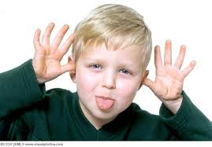
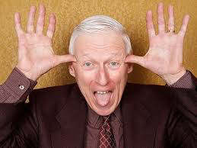
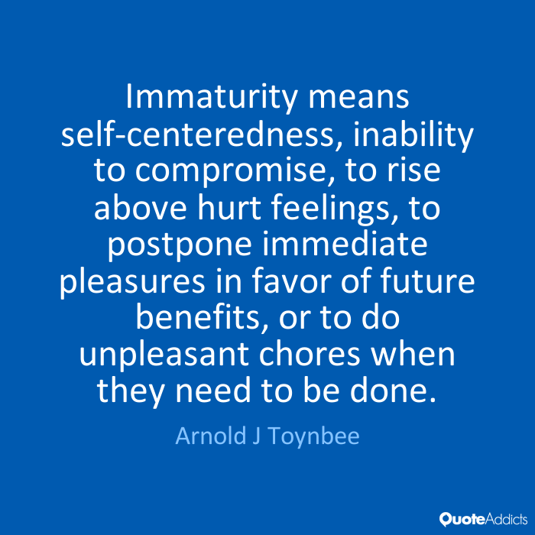
Pastor Gary Hart Date: 10-16-16 Text: Hebrews 5:11-6:20
Title: Go forward to maturity.
Introduction:(1)What does immaturity look like?
(2)What is immaturity?
(3)What does maturity look like?
(4)What is maturity?
(5)What are the marks of spiritual immaturity and the marks of spiritual maturity?
(1)

Slide 2
1. The Marks of Spiritual Immaturity(5:11-14). Spiritual immaturity is the lack of spiritual growth and development.
A. Drifting from the Word (2:1-4). These believers started on a “backward journey.” They wanted to return to Egypt.
B. Doubting the Word (3:7-4:13). These believers continued on a “downward journey.” They hardened their hearts through unbelief.
C. Dullness toward the Word (5:11). These believers contin-ued on a “wayward journey.” They were unable to listen, receive and obey the Word. They said, “Sunday school is dull, Bible Study is dull, preaching is dull, anything spiritual is dull.” They did not have the heart attitude of the Thessalon-ians: “And we also thank God continually because, when you received the word of God, which you heard from us, you accepted it not as a human word, but as it actually is, the word of God, which is indeed at work in you who believe”(2:13).
(2)

Slide 3
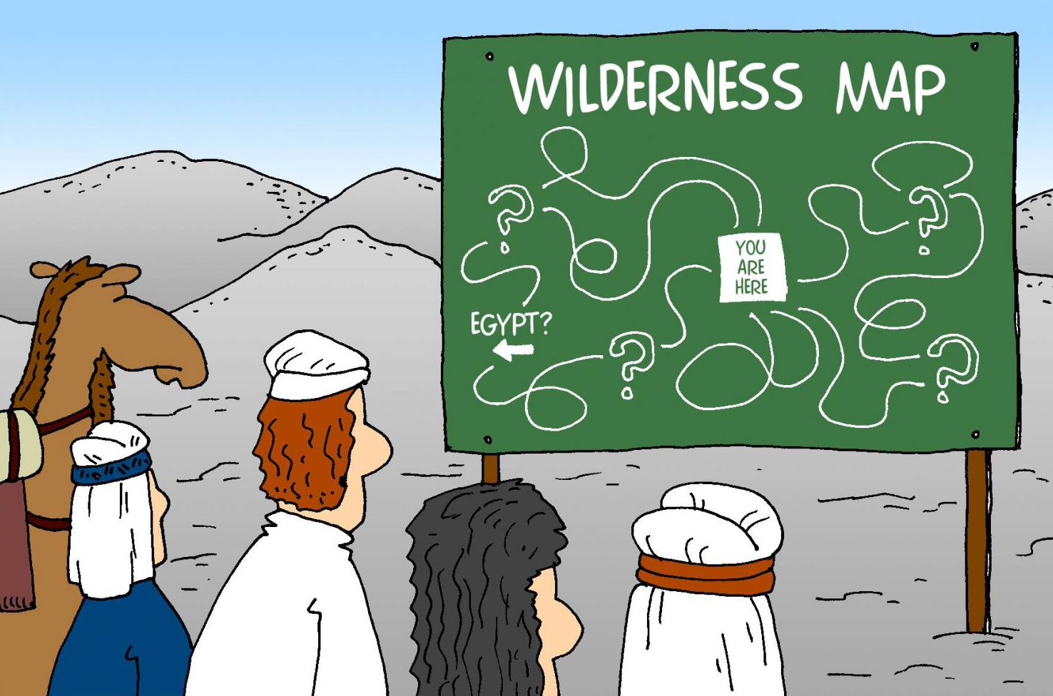
1. The Marks of Spiritual Immaturity(5:11-14).
D. Inability to share the Word (5:12a). These believers continued on a “silent journey.”
E. Inadequate diet of the Word (5:12b-13). These believers continued on a “starving journey.”
F. Unskilled in using the Word (5:14). These believers continued on a “wandering journey.”
Application: “Most Christians are ‘betweeners.’ They are between Egypt and Canaan—out of the place of danger, but not yet into the place of rest and promise. They are between Good Friday and Easter Sunday—saved by the blood but not yet enjoying the power of resurrection life.”
(3)

Slide 4
2. The Marks of Spiritual Maturity (6:1-20). Spiritual maturity is the life of spiritual growth and development (6:1).
A. Growing in the Word(6:1-3). These believers started on a “progress journey.” Therefore let us move beyond the elementary (ABCs) teachings about Christ” (6:1; Jn.8:31).
(1) Repentance—To repent is to change one’s mind.
(2) Faith in God—To believe in God, His Word, His promises.
(3) Baptisms—To wash as a symbol of cleansings(Ac.22:16) and identification with Christ in death, burial and resurrection (Ro.6:1-4).
(4) Laying on of hands—To share as a symbol of blessings (Lk.24:50) and a call to ministry(1T.4:14).
(5) Resurrection of the dead—To a future resurrection of the saved and the lost(Jn.5:24-29;Ac.24:14-15;Rev.20:4-6,12-15).
(6) Eternal judgment—To a future final judgment(Ac.17: 30- 31).
(4)

Slide 5
2. The Marks of Spiritual Maturity (6:1-20).
B. Growing follows salvation(6:4-6). These believers continued on a “persistent journey.”
Does this teach losing salvation?
(1) Interpret words. This is not the sin of apostasy(apostosia =willfully turn away), but the sin of unfaithfulness(parapipto =fall alongside). Compare Judas with Peter (IJn.2:19).
(2) Interpret obscure by the obvious. God assures the true believer that salvation can never be lost(6:13-20;Jn.5:24).
(3) Interpret context. They were “enlightened”(6:4;10:32) indicates an experience of true salvation. They “tasted the heavenly gift”(6:4b) and “tasted the goodness of the Word of God and the powers of the coming age”(6:5). God permitted His Son to “taste death for every man”(2:9). Taste carries the idea of experience. They “were partakers of (shared in) the Holy Spirit”(6:4c),“heavenly calling”(3:1), “Christ”(14).
(5)

Slide 6
2. The Marks of Spiritual Maturity (6:1-20).
C. Growing affects fruitfulness(6:7-10). These believers continued on a “fruitful journey.” A true believer produces a crop(6:7),the things that accompany salvation(6:9), and bears fruit for God’s glory(Jn.15:8). Not every believers bears the same amount of fruit (Mt.13:23); but every believer bears the same kind of fruit as proof that he is a child of God(Mt.7:15 -20). This the fruit of Christian character and conduct(Gal.5:22-16) produced by the Spirit as we mature in Christ including their love and work for Christ(6:10).
D. Growing demands diligent effort(6:11-12). These believ-ers continued on a “disciplined journey.” God does His part to carry us along to maturity(6:1,3),but it is also true that the be-liever must do our part. We must not be lazy but apply our-selves to the spiritual resources God has given us. We should exercise faith and patience to claim God’s promises.
(6)

Slide 7
2. The Marks of Spiritual Maturity (6:1-20).
E. Growing by claiming God’s promises(6:13-18). These believers continued on a “directed journey.” In spite of Abraham’s failures and sins, God kept His promise. Many of God’s promises do not depend on our character but on His faithfulness. He patiently endured (6:15;12:1-2).We must apply ourselves by faith. God not only gave Abraham a promise but He also confirmed that promise with an oath.
F. Growing by following Christ(6:19-20). These believers continued on a “obedient journey.” Christians have Christ our hope and our anchor.
(7)

Slide 8
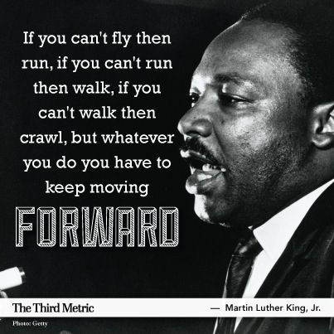
Application:Israel wanted to go back to Egypt,and a whole generation failed to inherit what God had promised.They were safely delivered out of Egypt, but they never enjoyed the promised rest in Canaan. We believers today can make the same mistake.
Conclusion: Where are you in your “spiritual journey”? Are you going backward or forward? Are you going forward to maturity on Higher Ground (#274)?
(1) “I’m pressing on the upward way, New heights I’m gaining every day; Still praying as I’m onward bound, ‘Lord, plant my feet on higher ground.’” (Chorus)
(8)

Slide 9
(Chorus) Lord, lift me up and let me stand
By faith on heaven's table land
A higher plane than I have found
Lord, plant my feet on higher ground.
(2) My heart has no desire to stay
Where doubts arise and fears dismay
Tho' some may dwell where these abound
My prayer, my aim is higher ground.(C)
(3) I want to live above the world
Tho' satan's darts at me are hurled
For faith has caught the joyful sound
The song of saints on higher ground.(C)
(4) I want to scale the utmost height
And catch a gleam of glory bright
But still I'll pray till heaven I've found
"Lord, lead me on to higher ground.”(C)
(9)

