Slide 1
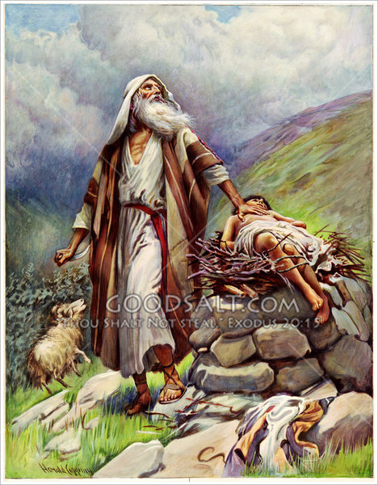
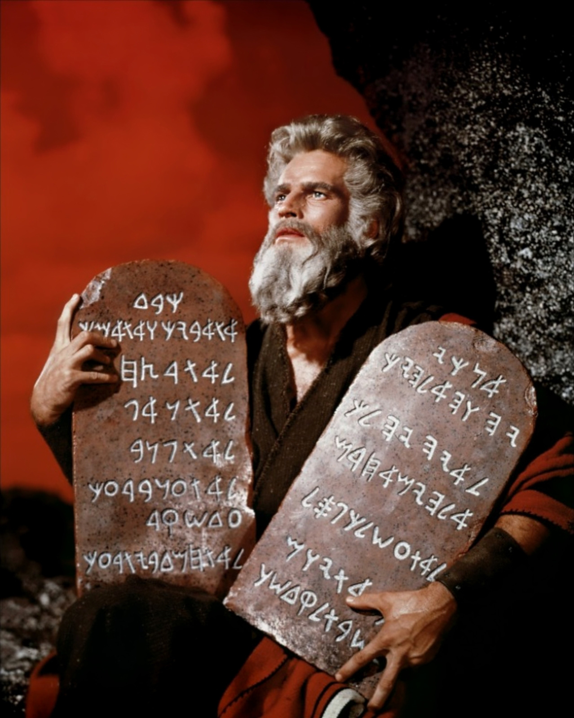
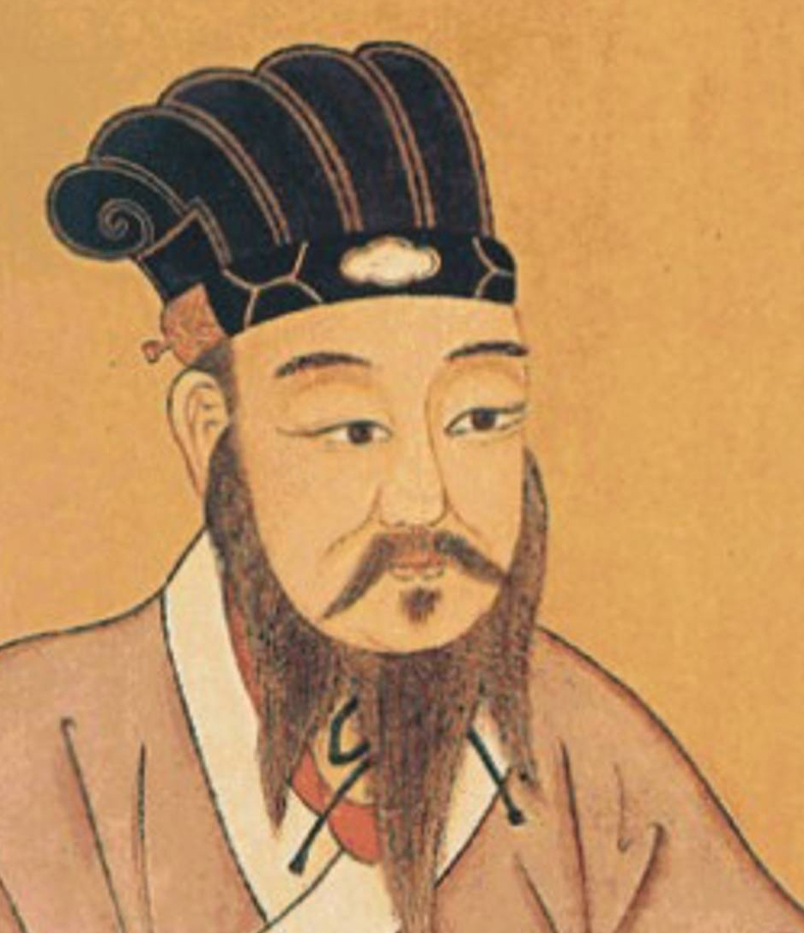
Pastor Gary Hart Date: 9-18-16 Text: Hebrews 3:1-6
Sermon Title: Greater than Moses
Introduction:Abraham was the founder and father of the Jews, but Moses was the deliverer and the giver of the law. Instead of going back, the Jews must go forward by following Christ who is greater than Abraham,Angels,and Moses.To the Chinese, Christ is greater than Ancestors,Spirits,and Confucius. Here we learn that Jesus Christ is superior to Moses in at least 3 ways.
(1)

Slide 2
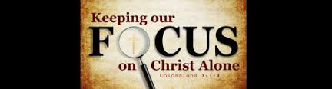
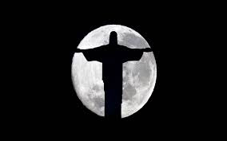
1. Christ is greater is His Person (3:1-2). Two descriptions make it clear that they were believers: “holy brothers and sisters” could only be applied to people in the family of God,and share in “the heavenly calling” could only refer to people in the church who also share “in Christ”(3:14). We are “members of His body”(Eph.5:30), who share “in the Holy Spirit”(Heb.6:4).
A. Christ is our Focus(3:1).
“Fix your thoughts on Jesus.”
This means to consider carefully and to understand fully” who He is.
B. Christ is our Apostle(3:1). Moses was a mere man,a prophet,and a leader.Christ is the Son of God,an apostle “sent with a commis-sion” by the Father into the world.Moses was called by God; Christ was sent as God’s “last Word” to sinful man. In the gospel of John, Jesus is referred to as “sent from God”(13:3). “For the law was given through Moses;grace and truth came through Jesus Christ”(Jn.1:17).
(2)

Slide 3
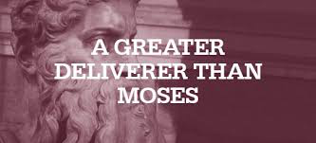
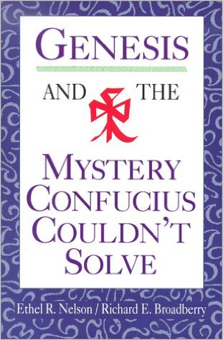
2. Christ is greater is His Ministry(3:3-6). The word “house” is used 6 times in these verses. It refers to the people of God, not to a material building.
A.Comparison between Moses and Christ. Moses ministered to Israel, the people of God under the old covenant. Today, Christ ministers to His church,the people of God under the new covenant. “We are His house”(3:6). David also spoke of two houses(2Sam.7).
B.Contrast between Moses and Christ. Moses was a servant in the house, while Christ is a Son over the house. Moses was a member of the household, but Christ built the house! This is also an argument for Christ’s deity. If God built all things, and Christ built God’s house, then Christ must be God. The prophet Moses spoke about things to come, but Christ brought the fulfillment of these things.
(3)
(2)

Slide 4
3. Christ is greater in the rest He gives (3:7-4:13). Three admonitions are spiritual lessons in the geography of Israel’s experiences.
A. Let us take heed (3:7-19). To the sad history of Israel, doubting and disbelieving the Word because of hardness of heart(Ps.95:7-11).
(1) Israel’s bondage in Egypt is an illustration of a sinner’s bondage in their world.
(2) Israel’s deliverance from Egypt by the blood of the lambs and the power of God, so a sinner who believes on Christ is delivered from the bondage of sin by the blood of “the Lamb of God” and the power of Christ’s death and resurrection (Col.1:13-14).
(3) Israel’s rest was found neither in Egypt nor in the wilderness, but their entry in the land of Canaan. They delayed because they doubted God’s promise (Num.13-14). “We are not able” said the ten spies and the people. “We are able with God’s help!” said Moses, Joshua, and Caleb. Because the people went backward in unbelief instead of forward by faith, they missed their inheritance and died in the wilderness. It was the new generation that possessed the land that entered into the rest.
(4)
(2)

Slide 5
*What does Canaan represent to us as Christians today? It represents our spiritual inheritance in Christ (Eph.1:3,11,15-23). Canann is not a picture of heaven and “crossing the Jordan” is not a picture of death. Since Canaan was a place of battles and even defeats,and Israel had to cross the river by faith (a picture of the believer as he dies to self and the world-Ro.6)and claims the inheritance by faith.They had to “step out by faith”
(Josh.1:3), and claim the land for themselves, just as believers today must do. They are “out of Egypt” but they are not yet “in Canaan.” The key word “rest” (occurs 12x in Heb.). There are 2 different “rests found in OT history: God’s Sabbath rest, when He ceased from His creation activities(Ge.2:2;Heb.4:4) and Israel’s rest in Canaan(Dt.12:9;Heb.3:11).
Past | Present | Future
God’s Sabbath rest | Salvation rest | Heaven
Israel’s Canaan rest | Submission rest | Victory in Christ
Application: The sin of Israel is apostasy, which is “departing (turning away) from the living God(3:12). Israel departed from God by refusing God’s will for their lives and stubbornly wanting to go their own way back to Egypt. God disciplined them in the wilderness.
(5)
(2)

Slide 6
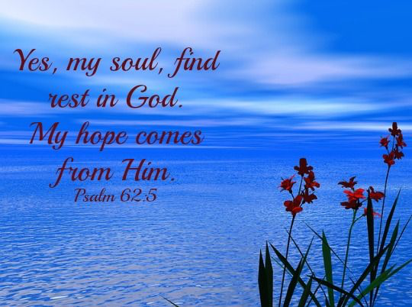
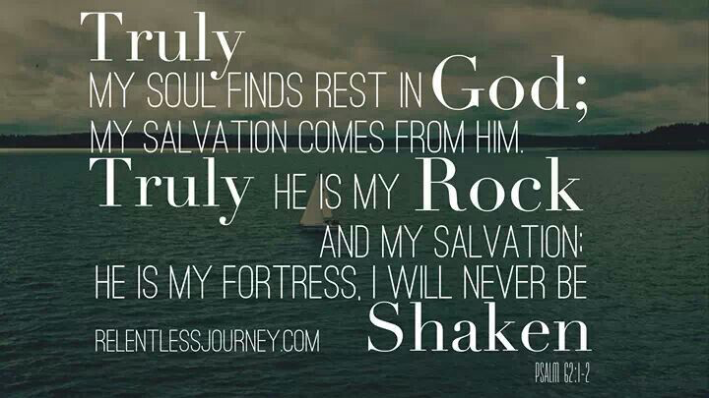
B. Let us be careful (4:1-8). We must be careful lest we fail to believe God’s Word, for it is only as the Word is mixed with faith that it can accomplish its purposes. It is by believing that we enter into rest, it is by obeying and surrendering to His will that rest enters into us.
(1) God finished His work and rested, so that His rest had been available since creation.
(2) The Jews failed to enter into their rest.
(3) God said that a rest was still available.
Application: There is a rest that still remains. We may enter into His rest by trusting His Word and obeying His will (Ps.62:1-2,5).
(6)

Slide 7
C. Let us make every effort (4:9-13). Diligence is the opposite of “drifting”(2:1-3). By paying attention to the Word of God(Ro.10:17).
(1) Not by our works. “For anyone who enters God’s rest also rests from their works”(4:10).
(2) By God’s finished work. God finished the work of creation, and Christ finished the work of the new creation.
(3) By God’s Word. “For the word of God is alive and active.”
(4:12). It is sharper than any double-edged sword (dagger). It penetrates and exposes the inner heart of man. It judges the thoughts and attitudes of the heart. In the Word we see God, and how God sees us.
Application:If we trust God, then the Word enables us to obey God and His promises. Joshua met Jesus and His sword(Josh.5:13-15).
(7)
(2)

Slide 8
Conclusion: Christ is greater than the angels, Abraham, Moses, and Joshua. Jesus said, “Come unto me, all you who are weary and burdened, and I will give you rest” (Mt. 11:28). When we come to Christ by faith, we find salvation rest. This is “peace with God” (Rom.5:1). Then Jesus said, “Take my yoke upon you and learn from me, for I am gentle and humble in heart, and you will find rest for your souls. For my yoke is easy and my burden is light” (Mt.11:29-30). When we yield and learn of Him and obey Him by faith, we enjoy submission rest. This is the “peace of God” (Phil.4:6-8). It is by believing that we enter into rest, it is by obeying and surrendering to His will that rest enters into us. Abraham, Angels, and Moses cannot bring rest to the Jews. Ancestors, Spirits, and Confucius cannot bring rest to the Chinese. Christ is greater, only He can bring rest. “Resting/Leaning on the everlasting arms” (#465).
(8)
(2)

Slide 9
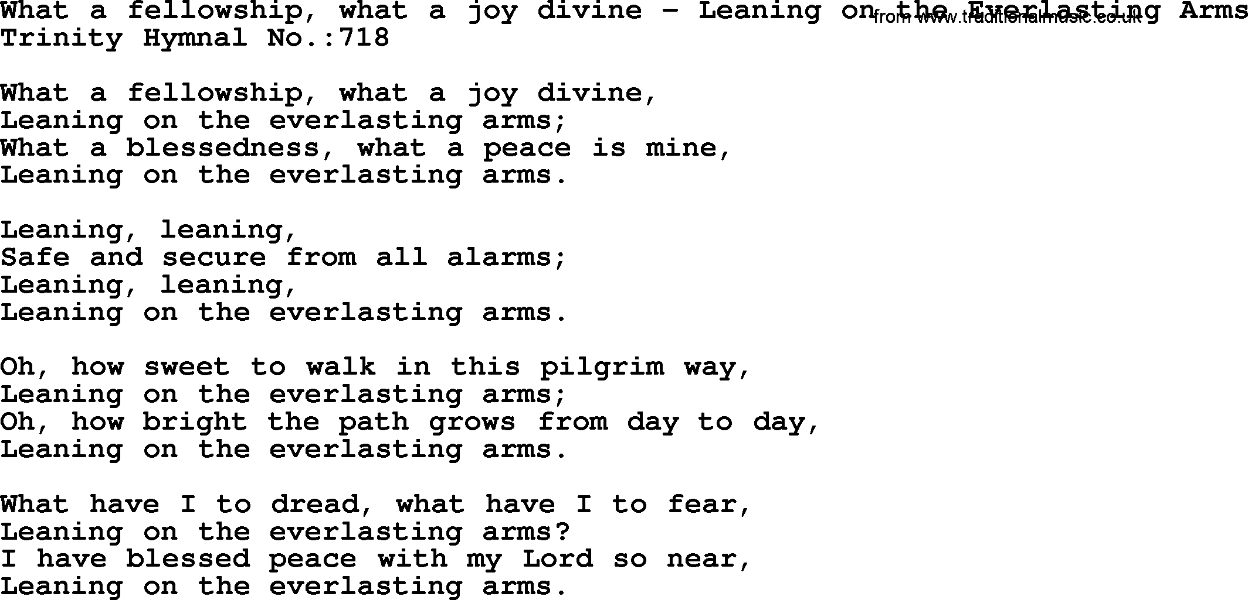
休
Rest by leaning on the tree.
信
Believe by leaning on the Word.
Resting/Leaning on the everlasting arms(#465)
The story behind the song:
Elisha Hoffman is author of more than 2,000 hymns. One day he received a letter from a friend in Alabama. In the letter his friend, a music teacher named A. J. Showalter, mentioned two of his former students, recent widowers. He told Elisha he’d tried consoling them with the words of Deut. 33:27 “The eternal God is our refuge, and underneath are the everlasting arms.”
(9)
(2)

