Slide 1
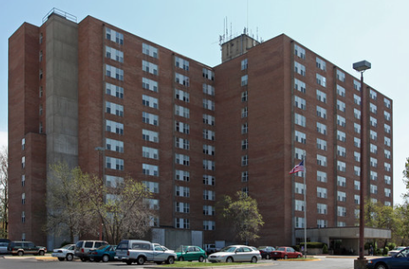
Welcome to sing Christmas Carols! 欢迎来唱圣诞颂歌！ Meet in the Lobby at 7:30pm. 晚上七点半在大堂见面。 Santa Fe Towers Apartments 8101 Santa Fe Drive Overland Park, KS 66103 Go to apartments to sing in English/Chinese. 去公寓用英文/中文唱歌。 Friday, Dec.15,2017 from 7:30 to 9:00 pm. 2017年12月15日星期五晚上从7:30到9:00。

Slide 2
主日:二零一七年十二月十日
Sunday: December 10, 2017
何礼义牧师 Pastor Gary Hart
题目:小亚细亚西部的教会。
Topic: “Western Asia Minor Church.”
经文:约一1:1-10 Text:1 John 1:1-10
“使你们与我们相交。我们乃是与父并他儿子耶稣基督相交的”(约一1:3)。
“So that you also may have fellowship with us. And our fellowship is with the Father and with his Son, Jesus Christ” (1Jn.1:3).
(1)
Notes:
“Shǐ nǐmen yǔ wǒmen xiàngjiāo. Wǒmen nǎi shì yǔ fù bìng tā érzi yēsū jīdū xiàngjiāo de”(yuē yī 1:3).

Slide 3
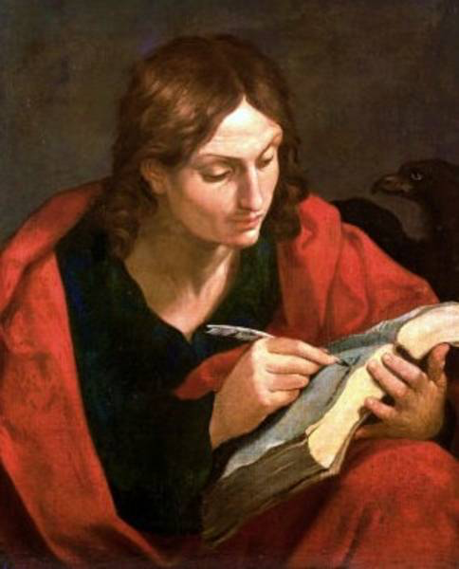
引言:A。约翰是谁？ Intro: A.Who is John?
(2)
“作长老的”(约二1:1; 约三1:1)。
(1)他是西庇太的儿子(可1:19)。
(2)他是渔夫(1:20)。
(3)他是耶稣的核心集团成员之一 (与雅各彼得)“耶稣所爱的门徒”(约13:23)。
(4)他写了约翰福音，约翰一，二，三书和启示录。
(5)他是一位牧师(在以弗所)。
“The elder”(2Jn.1:1;3Jn.1:1).
(1)He is the son of Zebedee(Mk.1:19-20).
(2)He was a fisherman(1:20).
(3)He was one of Jesus’ inner circle(with James and Peter)and the “disciple whom Jesus loved”(Jn.13:23).
(4)He wrote the Gospel of John,1,2,3John, and Revelation.
(5)He was a Pastor(at Ephesus).
Notes:
Yǐnyán:A. Yuēhàn shì shéi?
“Zuò zhǎnglǎo de”(yuē èr 1:1; Yuē sān 1:1). (1) Tā shì xī bì tài de érzi (kě 1:19). (2) Tā shì yúfū (1:20). (3) Tā shì yēsū de héxīn jítuán chéngyuán zhī yī (yǔ yǎ gè bǐdé)“yēsū suǒ ài de méntú”(yuē 13:23). (4) Tā xiěle yuēhàn fúyīn, yuēhàn yī, èr, sān shū hé qǐshì lù. (5) Tā shì yī wèi mùshī (zài yǐ fú suǒ).

Slide 4
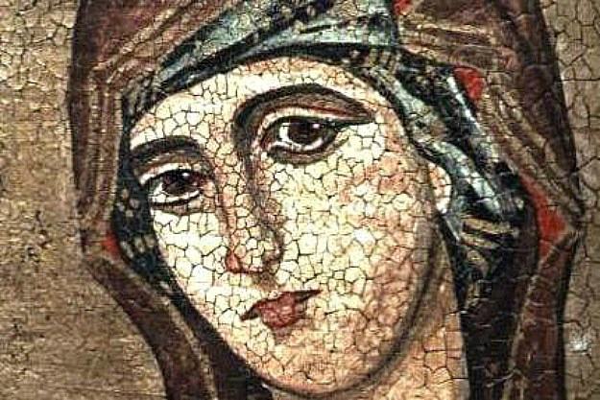
引言:B。约翰写信给谁？Intro:B.To whom did John write?
(3)
(1)约翰给小亚细亚的信徒写信。
(2)“写信给蒙拣选的太太和她的儿女”(约二1:1)。 这可能是小亚细亚西部的一个地方教会。
(3)“写信给亲爱的该犹”(约三1:1)。该犹也许是小亚细亚西部的教会的领袖。
(1)John wrote to believers in western Asia Minor.
(2)“To the lady chosen by God, and to her children”(2Jn.1:1). It was probably a local church in western Asia Minor.
(3) “To my dear friend Gaius”(3Jn.1:1).Gaius was perhaps a leader of the churches in western Asia Minor.
Notes:
Yǐnyán:B. Yuēhàn xiě xìn gěi shéi?
(1) Yuēhàn gěi xiǎoyàxìyà de xìntú xiě xìn. (2)“Xiě xìn gěi méng jiǎnxuǎn de tàitài hé tā de érnǚ”(yuē èr 1:1). Zhè kěnéng shì xiǎoyàxìyà xībù de yīgè dìfāng jiàohuì. (3)“Xiě xìn gěi qīn'ài de gāi yóu”(yuē sān 1:1). Gāi yóu yěxǔ shì xiǎoyàxìyà xībù de jiàohuì de lǐngxiù.

Slide 5
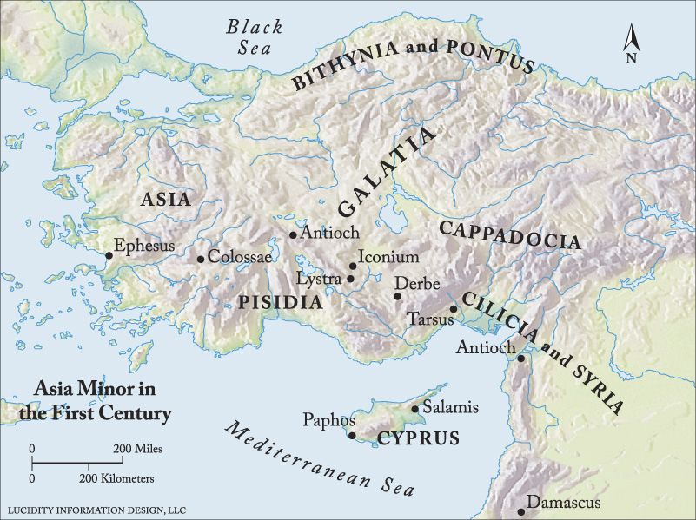
C。小亚细亚西部的地图。C. Map of Western Asia Minor.
(4)
Notes:
C. Xiǎoyàxìyà xībù dì dìtú.

Slide 6
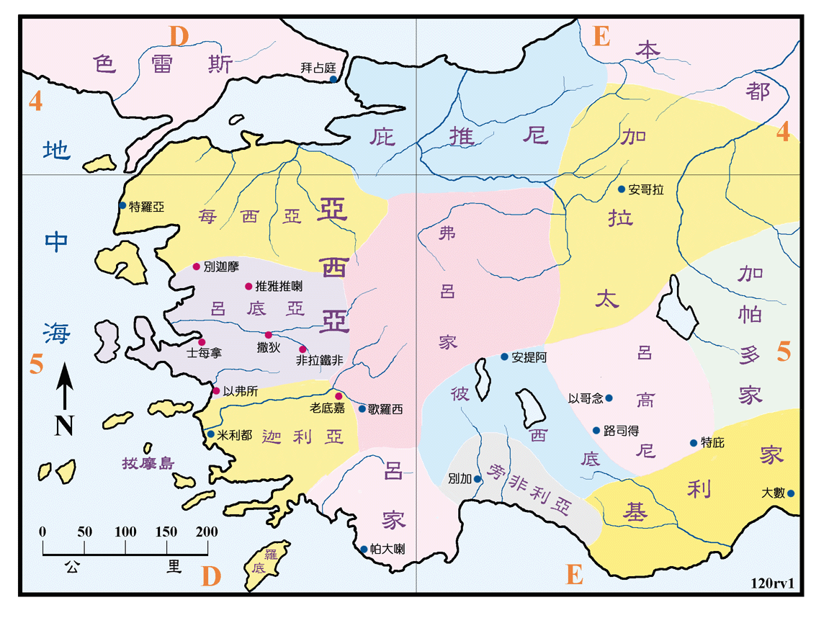
C。小亚细亚西部的地图。C. Map of Western Asia Minor.
(4)
Notes:
C. Xiǎoyàxìyà xībù dì dìtú.

Slide 7
D。对教会的信息是什么？D.What is message to the Church?
(1)一个关键词是“爱”(约一，二，三，53次)。
(2)另一个关键词是真理(约一，二，三，21次)。
(3)关键词是“团契”(约一1次; 新约9次; 圣经94次)。早期的教会“都恒心遵守使徒的教训，彼此交接”(徒2:42)。 “神是信实的，你们原是被他所召，好与他儿子，我们的主耶稣基督，一同得分”(林前1:9)。我们要象雅各，彼得和约翰对保罗和巴拿巴所行的那样，伸出右手行相交之礼(加2:9)。 我们要与神和彼此交通，但要与假教师断交。 什么是真正的团契？ 就像一个在马戏团里吃棉花糖的孩子一样，许多人想咬到一大口，却什么也没咬到。
(1)One key word is “love”(1,2,3 John-53x).
(2)Another key word is “truth”(1,2,3John-21x).
(3)A key word is “fellowship”(1John-4x; NT-9x; Bible-94x).The early church “devoted themselves to teaching and fellowship”(Ac.2:42). “God is faithful, who has called you into fellowship with his Son, Jesus Christ our Lord”(1Cor.1:9). We are to extend the right hand of fellowship, like James, Peter and John did to Paul and Barnabas (Ga.2:9). We are to have fellowship with God and with one another, but break fellowship with false teachers. What is real fellowship? Like a child eating cotton candy at the circus, many people who expect to bite into something real end up with a mouthful of nothing.
(5)
Notes:
D. Duì jiàohuì de xìnxī shì shénme?
(1) Yīgè guānjiàn cí shì “ài”(yuē yī, èr, sān,53 cì). (2) Lìng yīgè guānjiàn cí shì zhēnlǐ (yuē yī, èr, sān,21 cì). (3) Guānjiàn cí shì “tuán qì”(yuē yī 1 cì; xīn yuē 9 cì; shèngjīng 94 cì). Zǎoqí de jiàohuì “dōu héngxīn zūnshǒu shǐtú de jiàoxùn, bǐcǐ jiāojiē”(tú 2:42). “Shén shì xìnshí de, nǐmen yuán shì bèi tāsuǒ zhào, hǎo yǔ tā érzi, wǒmen de zhǔ yēsū jīdū, yītóng défēn”(lín qián 1:9). Wǒmen yào xiàng yǎ gè, bǐdé hé yuēhàn duì bǎoluó hé bā ná bā suǒ xíng dì nàyàng, shēn chū yòushǒu xíng xiàngjiāo zhī lǐ (jiā 2:9). Wǒmen yào yǔ shén hé bǐcǐ jiāotōng, dàn yào yǔ jiǎ jiàoshī duànjiāo. Shénme shì zhēnzhèng de tuán qì? Jiù xiàng yīgè zài mǎxì tuán lǐ chī miánhuā táng de háizi yīyàng, xǔduō rén xiǎng yǎo dào yī dàkǒu, què shénme yě méi yǎo dào.

Slide 8
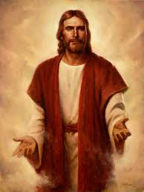
一。真正团契的事实。1.Facts about real fellowship.
(6)
A。这个生命是显露的。“论到从起初原有的生命之道，就是我们所听见所看见,亲眼看过,亲手摸过的”(1:1)。神在创造中启示自己(罗1:20);在他的圣经中(提后3:16),在他的儿子耶稣基督里显现。 “人看见了我，就是看见了父”(约14:9)。
A.This Life is revealed. “That which was from the beginning, which we have heard, which we have seen with our eyes,which we have looked at and our hands have touched—this we proclaim concerning the Word of life”(1:1).God has revealed Himself in creation(Ro.1:20);in His Word,the Bible(2Ti.3:16);and in His Son, Jesus Christ. “Anyone who has seen me has seen the Father”(Jn.14:9).
Notes:
Yī. Zhēnzhèng tuán qì de shìshí.
A. Zhège shēngmìng shì xiǎnlù de.“Lùn dào cóng qǐchū yuán yǒu de shēngmìng zhī dào, jiùshì wǒmen suǒ tīngjiàn suǒ kànjiàn, qīnyǎn kànguò, qīnshǒu mōguò de”(1:1). Shén zài chuàngzào zhōng qǐshì zìjǐ (luō 1:20); Zài tā de shèngjīng zhōng (tí hòu 3:16), Zài tā de érzi yēsū jīdū lǐ xiǎnxiàn. “Rén kànjiànle wǒ, jiùshì kànjiànle fù”(yuē 14:9).

Slide 9
一。真正团契的事实。1.Facts about real fellowship.
(7)
B。这个生命是有经验的。“这生命已经显现出来，我们也看见过，现在又作见证，将原与父同在，且显现与我们那永远的生命，传给你们”(1:2)。 约翰写了约翰福音告诉人们如何得到这个生命。“但记这些事，要叫你们信耶稣是基督，是神的儿子。并且叫你们信了他，就可以因他的名得生命”(20:31)。他写了约翰一书，告诉人们如何确定他们真的是神所生的。“这见证，就是神赐给我们永生，这永生也是在他儿子里面。人有了神的儿子就有生命。没有神的儿子就没有生命”(约一5:11-12)。
B.This Life is experienced. “The life appeared;we have seen it and testify to it,and we proclaim to you the eternal life, which was with the Father and has appeared to us”(1:2).John wrote the Gospel of John to tell people how to receive this life. “But these are written that you may believe that Jesus is the Messiah, the Son of God, and that by believing you may have life in his name”(Jn.20:31). He wrote 1 John to tell people how to be sure that they really been born of God. “And this is the testimony:God has given us eternal life,and this life is in his Son.Whoever has the Son has life;whoever does not have the Son of God does not have life” (1Jn.5:11-12).
Notes:
B. Zhège shēngmìng shì yǒu jīngyàn de.“Zhè shēngmìng yǐjīng xiǎnxiàn chūlái, wǒmen yě kànjiànguò, xiànzài yòu zuò jiànzhèng, jiāng yuán yǔ fù tóng zài, qiě xiǎnxiàn yǔ wǒmen nà yǒngyuǎn de shēngmìng, chuán gěi nǐmen”(1:2). Yuēhàn xiěle yuēhàn fúyīn gàosù rénmen rúhé dédào zhège shēngmìng.“Dàn jì zhèxiē shì, yào jiào nǐmen xìn yēsū shì jīdū, shì shén de érzi. Bìngqiě jiào nǐmen xìnle tā, jiù kěyǐ yīn tā de míng dé shēngmìng”(20:31). Tā xiěle yuēhàn yī shū, gàosù rénmen rúhé quèdìng tāmen zhēn de shì shén suǒ shēng de.“Zhè jiànzhèng, jiùshì shén cì gěi wǒmen yǒngshēng, zhè yǒngshēng yěshì zài tā érzi lǐmiàn. Rén yǒule shén de érzi jiù yǒu shēngmìng. Méiyǒu shén de érzi jiù méiyǒu shēngmìng”(yuē yī 5:11-12).

Slide 10
一。真正团契的事实。1.Facts about real fellowship.
(8)
C。这个生命是共享的。“我们将所看见，所听见的，传给你们，使你们与我们相交。我们乃是与父并他儿子耶稣基督相交的。我们将这些话写给你们，使你们的喜乐充足”(1:3-4)。
分享有五个目的。
(1)我们有许多交通。
(2)我们可能有喜乐。团契是神对生命孤独的
回应。 喜乐是祂对生命空虚的回答(诗16:11)。
Koinonia is a Greek word that occurs 20 times in the Bible. Its primary meaning is “fellowship, sharing in common, commun-ion.” Christian fellowship is a key aspect of the Christian life. Believers in Christ are to come together in love, faith, and encouragement.
Koinonia是一个希腊词，在圣经中出现20次。 它的主要意思是“友谊，共同分享，共融”。基督徒的团契是基督徒生活的一个关键方面。 在基督里的信徒要以爱，信心和鼓励走到一起。
C.This Life is shared. “We proclaim to you what we have seen and heard,so that you also may have fellowship with us. And our fellowship is with the Father and with his Son,Jesus Christ.We write this to make our joy complete”(1:3-4). There are 5 purposes for sharing.
(1)That we many have fellowship.
(2)That we may have joy. Fellowship is God’s answer to the loneliness of life. Joy is His answer to the emptiness of life(Ps.16:11).
Notes:
C. Zhège shēngmìng shì gòngxiǎng de.“Wǒmen jiāng suǒ kànjiàn, suǒ tīngjiàn de, chuán gěi nǐmen, shǐ nǐmen yǔ wǒmen xiàngjiāo. Wǒmen nǎi shì yǔ fù bìng tā érzi yēsū jīdū xiàngjiāo de. Wǒmen jiāng zhèxiē huà xiě gěi nǐmen, shǐ nǐmen de xǐlè chōngzú”(1:3-4). Fēn xiǎng yǒu wǔ gè mùdì. (1) Wǒmen yǒu xǔduō jiāotōng. (2) Wǒmen kěnéng yǒu xǐlè. Tuán qì shì shén duì shēngmìng gūdú de huíyīng. Xǐlè shì tā duì shēngmìng kōngxū de huídá (shī 16:11).
Koinonia shì yīgè xīlà cí, zài shèngjīng zhòng chūxiàn 20 cì. Tā de zhǔyào yìsi shì “yǒuyì, gòngtóng fēnxiǎng, gòng róng”. Jīdū tú de tuán qì shì jīdū tú shēnghuó de yīgè guānjiàn fāngmiàn. Zài jīdū lǐ de xìntú yào yǐ ài, xìnxīn hé gǔlì zǒu dào yīqǐ.

Slide 11
一。真正团契的事实。1.Facts about real fellowship.
(9)
(3)我们不犯罪。“我小子们哪，我将这些话写给你们，是要叫你们不犯罪。若有人犯罪，在父那里我们有一位中保，就是那义者耶稣基督” (约一2:1)。 撒但可能是我们的控告者(启12:10)。 基督是我们的中保。
(4)我们不会被欺骗。“我将这些话写给你们，是指着那引诱你们的人说的” (2:26)。
(5)我们知道我们得救了。“我将这些话写给你们信奉神儿子之名的人，要叫你们知道自己有永生” (5:13)。
(3)That we may not sin. “My dear children,I write this to you so that you will not sin.But if anybody does sin,we have an advocate with the Father—Jesus Christ, the Righteous One”(1Jn.2:1). Satan may be our accuser(Rev.12:10). Christ is our advocate.
(4)That we may not be deceived. “I am writing these things to you about those who are trying to lead you astray”(2:26).
(5)That we may know we are saved. “I write these things to you who believe in the name of the Son of God so that you may know that you have eternal life”
(5:13).
Notes:
(3) Wǒmen bù fànzuì.“Wǒ xiǎozimen nǎ, wǒ jiāng zhèxiē huà xiě gěi nǐmen, shì yào jiào nǐmen bù fànzuì. Ruò yǒurén fànzuì, zài fù nàlǐ wǒmen yǒuyī wèi zhōngbǎo, jiùshì nà yì zhě yēsū jīdū” (yuē yī 2:1). Sā dàn kěnéng shì wǒmen de kònggào zhě (qǐ 12:10). Jīdū shì wǒmen de zhōng bǎo. (4) Wǒmen bù huì bèi qīpiàn.“Wǒ jiāng zhèxiē huà xiě gěi nǐmen, shì zhǐzhe nà yǐnyòu nǐmen de rén shuō de” (2:26). (5) Wǒmen zhīdào wǒmen déjiùle.“Wǒ jiāng zhèxiē huà xiě gěi nǐmen xìnfèng shén er zǐ zhī míng de rén, yào jiào nǐmen zhīdào zìjǐ yǒu yǒngshēng” (5:13).

Slide 12
(10)
二。真正团契的条件。2.Conditions for real fellowship.
任何形式的生命都有它的敌人。真正的生命也有敌人。 这敌人就是罪(9次)。罪是外在的不顺服和内在的叛逆(3:4; 2:16)。神是光明，罪是黑暗。行走和说话也有对比。 “如果我们说”或“他说”(4次)。有三种对待罪的方法。
A。我们可以试图掩盖我们的罪过。 我们怎样掩盖罪恶？(1)我们把谎言告诉别人(1:6)。(2)我们说谎或欺骗自己(1:8)。(3)我们试图对神说谎(1:10)。即使是基督徒也可能为自己的交往，性格和行为说谎。我们必须对自己，他人和神诚实。这个过程始于说谎的过程，终于造就一个说谎者。
Every form of life has its enemies.The life that is real also has an enemy. This enemy is sin(9x).Sin is outward disobedience and inward rebellion(3:4;2:16).God is light;sin is darkness.There is also a contrast between walking and talking. “If we say” or “he that says”(4x). There are 3 approaches to sin.
A.We can try to cover our sins. How do we cover up sins? (1)We tell lies to others (1:6). (2)We lie or deceive ourselves(1:8).(3)We try to lie to God(1:10).Even a Christian can lie about their fellowship,their nature,and their actions.We must be honest with ourselves, honest with others, and honest with God. The process starts with telling lies and ends with becoming a liar!
Notes:
Èr. Zhēnzhèng tuán qì de tiáojiàn.
Rènhé xíngshì de shēngmìng dōu yǒu tā de dírén. Zhēnzhèng de shēngmìng yěyǒu dírén. Zhè dírén jiùshì zuì (9 cì). Zuì shì wài zài de bù shùnfú hé nèizài de pànnì (3:4; 2:16). Shén shì guāngmíng, zuì shì hēi'àn. Xíngzǒu hé shuōhuà yěyǒu duìbǐ. “Rúguǒ wǒmen shuō” huò “tā shuō”(4 cì). Yǒusān zhǒng duìdài zuì de fāngfǎ. A. Wǒmen kěyǐ shìtú yǎngài wǒmen de zuìguo. Wǒmen zěnyàng yǎngài zuì'è?(1) Wǒmen bǎ huǎngyán gàosù biérén (1:6).(2) Wǒmen shuōhuǎng huò qīpiàn zìjǐ (1:8).(3) Wǒmen shìtú duì shén shuōhuǎng (1:10). Jíshǐ shì jīdū tú yě kěnéng wéi zìjǐ de jiāowǎng, xìnggé hé xíngwéi shuōhuǎng. Wǒmen bìxū duì zìjǐ, tārén hé shén chéngshí. Zhège guòchéng shǐ yú shuōhuǎng de guòchéng, zhōngyú zàojiù yīgè shuōhuǎng zhě.

Slide 13
(11)
二。真正团契的条件。2.Conditions for real fellowship.
B。我们可以承认我们的罪。承认罪就是说上帝对此说的同样的话。神应许原谅我们(约一1：9)。 “遮掩自己罪过的，必不亨通。承认离弃罪过的，必蒙怜恤”(箴28:13)。
B.We can confess our sins.To confess sin means to say the same thing about it that God says about it.God promises to forgive us(1Jn.1:9). “Whoever conceals their sins does not prosper, but the one who confesses and renounces them finds mercy”(Pr.28:13).
我们若认自己的罪，神是信实的，是公义的，必要赦免我们的罪，洗净我们一切的不义(约一1:9)。
Notes:
B. Wǒmen kěyǐ chéngrèn wǒmen de zuì. Chéngrèn zuì jiùshì shuō shàngdì duì cǐ shuō de tóngyàng dehuà. Shén yīngxǔ yuánliàng wǒmen (yuē yī 1:9). “Zhēyǎn zìjǐ zuìguo de, bì bù hēngtōng. Chéngrèn líqì zuìguo de, bì méng liánxù”(zhēn 28:13).
Wǒmen ruò rèn zìjǐ de zuì, shén shì xìnshí de, shì gōng yì de, bìyào shèmiǎn wǒmen de zuì, xǐ jìng wǒmen yīqiè de bù yì (yuē yī 1:9).

Slide 14
(12)
二。真正团契的条件。2.Conditions for real fellowship.
C。我们可以胜过我们的罪(2:1-3,5-6)。胜过罪的秘诀就是“行在光明中”(1:7)。行在光中意味着开放，诚实， 真诚的(“没有蜡”)，有三个服从的动机。 (1)我们可以服从，因为我们必须(像奴隶一样)。(2)我们可以服从，因为我们需要(像一个雇员)。(3)我们可以服从，因为我们想要(像一个爱的关系)。在光下行走需要诚实，顺从和爱。 这也是跟随基督的榜样，走在路上(2:6)。
C.We can conquer our sins(2:1-3,5-6).The secret of victory over sin is to “walk in the light”(1:7).To walk in the light means to be open,honest,sincere (“without wax”).There are 3 motives for obedience.
(1)We can obey because we have to.
(2)We can obey because we need to.
(3)We can obey because we want to(like
a love relationship).Walking in the light
involves honesty, obedience and love.
It also is following the example of Christ
and walking as He walked(2:6).
Notes:
C. Wǒmen kěyǐ shèngguò wǒmen de zuì (2:1-3,5-6). Shèngguò zuì de mìjué jiùshì “xíng zài guāngmíng zhōng”(1:7). Xíng zài guāng zhòng yìwèizhe kāifàng, chéngshí, zhēnchéng de (“méiyǒu là”), yǒusān gè fúcóng de dòngjī. (1) Wǒmen kěyǐ fúcóng, yīnwèi wǒmen bìxū (xiàng núlì yīyàng).(2) Wǒmen kěyǐ fúcóng, yīnwèi wǒmen xūyào (xiàng yīgè gùyuán).(3) Wǒmen kěyǐ fúcóng, yīnwèi wǒmen xiǎng yào (xiàng yīgè ài de guānxì). Zài guāng xià xíngzǒu xūyào chéngshí, shùncóng hé ài. Zhè yěshì gēnsuí jīdū de bǎngyàng, zǒu zài lùshàng (2:6).

Slide 15
(13)
三。真正团契的表征。3. Signs of real fellowship.
基督徒为什么要彼此相爱有三个好理由。
A。神命令我们去爱(2:7-11)。 “新”有两个词，一个意思是“新的时间”，另一个意思是“新的质量”(最近与新鲜)。
B。我们是上帝所生，上帝的爱在我们里面(3:10-24)。 “主为我们舍命，我们从此就知道何为爱。我们也当为弟兄舍命。凡有世上财物的，看见弟兄穷乏，却塞住怜恤的心，爱神的心怎能存在他里面呢？” (3:16-18).
There are three good reasons why Christians should love one another.
A.God has commanded us to love(2:7-11). There are two words for “new” one means “new in time” and the other means “new in quality”(recent vs. fresh). B.We have been born of God and God’s love lives in us(3:10-24). “This is how we know what love is: Jesus Christ laid down his life for us. And we ought to lay down our lives for our brothers and sisters.If anyone has material possessions and sees a brother or sister in need but has no pity on them, how can the love of God be in that person?Dear children, let us not love with words or speech but with actions and in truth”(3:16-18).
Notes:
Sān. Zhēnzhèng tuán qì de biāozhèng.
Jīdū tú wèishéme yào bǐcǐ xiāng'ài yǒusān gè hǎo lǐyóu. A. Shén mìnglìng wǒmen qù ài (2:7-11). “Xīn” yǒu liǎng gè cí, yīgè yìsi shì “xīn de shíjiān”, lìng yīgè yìsi shì “xīn de zhìliàng”(zuìjìn yǔ xīnxiān). B. Wǒmen shìshàngdì suǒ shēng, shàngdì de ài zài wǒmen lǐmiàn (3:10-24). “Zhǔ wèi wǒmen shěmìng, wǒmen cóngcǐ jiù zhīdào hé wèi ài. Wǒmen yě dāng wèi dìxiōng shěmìng. Fán yǒu shì shàng cáiwù de, kànjiàn dìxiōng qióngfá, què sāi zhù liánxù de xīn, ài shén de xīn zěn néng cúnzài tā lǐmiàn ne?” (3:16-18).

Slide 16
(14)
三。真正团契的表征。3. Signs of real fellowship.
C。神显明他对我们的爱(4:7-21)。“亲爱的弟兄阿，我们应当彼此相爱。因为爱是从神来的。凡有爱心的，都是由神而生，并且认识神。没有爱心的，就不认识神。因为神就是爱。神差他独生子到世间来，使我们借着他得生，神爱我们的心，在此就显明了。不是我们爱神，乃是神爱我们，差他的儿子，为我们的罪作了挽回祭，这就是爱了。亲爱的弟兄阿，神既是这样爱我们，我们也当彼此相爱。从来没有人见过神。我们若彼此相爱，神就住在我们里面，爱他的心在我们里面得以完全了” (4:7-12)。
C.God revealed His love to us(4:7-21). “Dear friends, let us love one another, for love comes from God. Everyone who loves has been born of God and knows God. Whoever does not love does not know God, because God is love.This is how God showed his love among us: He sent his one and only Son into the world that we might live through him. This is love:not that we loved God,but that he loved us and sent his Son as an atoning sacrifice for our sins. Dear friends,since God so loved us, we also ought to love one another.No one has ever seen God; but if we love one another, God lives in us and his love is made complete in us”(4:7-12).
Notes:
C. Shén xiǎnmíng tā duì wǒmen de ài (4:7-21).“Qīn'ài de dìxiōng ā, wǒmen yīngdāng bǐcǐ xiāng'ài. Yīnwèi ài shì cóng shén lái de. Fán yǒu àixīn de, dōu shì yóu shén ér shēng, bìngqiě rènshì shén. Méiyǒu àixīn de, jiù bù rènshì shén. Yīnwèi shén jiùshì ài. Shén chāi tā dúshēngzǐ dào shìjiān lái, shǐ wǒmen jièzhe tā dé shēng, shén ài wǒmen de xīn, zài cǐ jiù xiǎnmíngliǎo. Bùshì wǒmen ài shén, nǎi shì shén ài wǒmen, chà tā de érzi, wèi wǒmen de zuì zuòle wǎnhuí jì, zhè jiùshì àile. Qīn'ài de dìxiōng ā, shén jìshì zhèyàng ài wǒmen, wǒmen yě dāng bǐcǐ xiāng'ài. Cónglái méiyǒu rén jiànguò shén. Wǒmen ruò bǐcǐ xiāng'ài, shén jiù zhù zài wǒmen lǐmiàn, ài tā de xīn zài wǒmen lǐmiàn déyǐ wánquánle” (4:7-12).

Slide 17
(15)
四。真正团契的警告。4.Warnings about real fellowship.
A。他们离开了。“小子们哪，如今是末时了。你们曾听见说，那敌基督的要来现在已经有好些敌基督的出来了。从此我们就知道如今是末时了。他们从我们中间出去，却不是属我们的。若是属我们的，就必仍旧与我们同在。他们出去，显明都不是属我们的”(2: 18-19) 。
B。他们试图欺骗(2:26-29)。
C。他们是伪装者。 “从此就显出谁是神的儿女，谁是魔鬼的儿女。凡不行义的，就不属神。不爱弟兄的也是如此” (3:10)。
A.They depart. “Dear children, this is the last hour;and as you have heard that the antichrist is coming,even now many antichrists have come.This is how we know it is the last hour. They went out from us, but they did not really belong to us. For if they had belonged to us, they would have remained with us; but their going showed that none of them belonged to us”(2:18-19).
B.They try to deceive(2:26-29).
C.They are pretenders. “This is how we know who the children of God are and who the children of the devil are:Anyone who does not do what is right is not God’s child,nor is anyone who does not love their brother and sister.” (3:10).
Notes:
Sì. Zhēnzhèng tuán qì de jǐnggào.
有事实背后的后果。There are consequences of turning from the truth.
A. Tāmen líkāile.“Xiǎozimen nǎ, rújīn shì mò shíliǎo. Nǐmen céng tīngjiàn shuō, nà dí jīdū de yāo lái xiànzài yǐjīng yǒu hǎoxiē dí jīdū de chūláile. Cóngcǐ wǒmen jiù zhīdào rújīn shì mò shíliǎo. Tāmen cóng wǒmen zhōngjiān chūqù, què bùshì shǔ wǒmen de. Ruòshì shǔ wǒmen de, jiù bì réngjiù yǔ wǒmen tóng zài. Tāmen chūqù, xiǎnmíng dōu bùshì shǔ wǒmen de”(2: 18-19). B. Tāmen shìtú qīpiàn (2:26-29). C. Tāmen shì wèizhuāng zhě. “Cóngcǐ jiù xiǎn chū shéi shì shén de érnǚ, shéi shì móguǐ de érnǚ. Fán bùxíng yì de, jiù bù shǔ shén. Bù ài dìxiōng de yěshì rúcǐ” (3:10).

Slide 18
(16)
四。真正团契的警告。4.Warnings about real fellowship.
D。他们要被试炼。“亲爱的弟兄阿，一切的灵，你们不可都信。总要试验那些灵是出于神的不是。因为世上有许多假先知已经出来了。凡灵认耶稣基督是成了肉身来的，就是出于神的。从此你们可以认出神的灵来。凡灵不认耶稣，就不是出于神。这是那敌基督者的灵。你们从前听见他要来。现在已经在世上了。... 他们是属世界的。所以论世界的事，世人也听从他们。我们是属神的。认识神的就听从我们。不属神的就不听从我们。从此我们可以认出真理的灵，和谬妄的灵来” (4:1-3,5-6)。
D.They are to be tested. “Dear friends,do not believe every spirit,but test the spirits to see whether they are from God, because many false prophets have gone out into the world.This is how you can recognize the Spirit of God:Every spirit that acknowledges that Jesus Christ has come in the flesh is from God,but every spirit that does not ack-nowledge Jesus is not from God.This is the spirit of the antichrist, which you have heard is coming and even now is already in the world…They are from the world and therefore speak from the viewpoint of the world,and the world listens to them.We are from God, and whoever knows God listens to us; but whoever is not from God does not listen to us.This is how we recognize the Spirit of truth and the spirit of falsehood”(4:1-3,5-6).
Notes:
D. Tāmen yào bèi shì liàn.“Qīn'ài de dìxiōng ā, yīqiè de líng, nǐmen bùkě dōu xìn. Zǒng yào shìyàn nàxiē líng shì chū yú shén de bùshì. Yīnwèi shìshàng yǒu xǔduō jiǎ xiānzhī yǐjīng chūláile. Fán líng rèn yēsū jīdū shì chéngle ròushēn lái de, jiùshì chū yú shén de. Cóngcǐ nǐmen kěyǐ rèn chū shén de líng lái. Fán líng bù rèn yēsū, jiù bùshì chū yú shén. Zhè shì nà dí jīdū zhě de líng. Nǐmen cóngqián tīngjiàn tā yào lái. Xiànzài yǐjīng zài shìshàngle.... Tāmen shì shǔ shìjiè de. Suǒyǐ lùn shìjiè de shì, shìrén yě tīngcóng tāmen. Wǒmen shì shǔ shén de. Rènshì shén de jiù tīngcóng wǒmen. Bù shǔ shén de jiù bù tīngcóng wǒmen. Cóngcǐ wǒmen kěyǐ rèn chū zhēnlǐ de líng, hé miù wàng de líng lái” (4:1-3,5-6).

Slide 19
(17)
四。真正团契的警告。4.Warnings about real fellowship.
E。他们不受欢迎(约二7-11)。“因为世上有许多迷惑人的出来，他们不认耶稣基督是成了肉身来的。这就是那迷惑人，敌基督的。...若有人到你们那里，不是传这教训，不要接他到家里，也不要问他的安。因为问他安的，就在他的恶行上有分”(7,10-11)。
E.They are not welcome(2Jn.7-11). “I say this because many deceivers, who do not acknowledge Jesus Christ as coming in the flesh, have gone out into the world. Any such person is the deceiver and the antichrist.If anyone comes to you and does not bring this teaching, do not take them into your house or welcome them. Anyone who welcomes them shares in their wicked work”(v.7,10-11).
谢绝推销。
我们不给陌生人开门。
Notes:
E. Tāmen bù shòu huānyíng (yuē èr 7-11).“Yīnwèi shìshàng yǒu xǔduō míhuò rén de chūlái, tāmen bù rèn yēsū jīdū shì chéngle ròushēn lái de. Zhè jiùshì nà míhuò rén, dí jīdū de.... Ruò yǒurén dào nǐmen nàlǐ, bùshì chuán zhè jiàoxùn, bùyào jiē tā dào jiālǐ, yě bùyào wèn tā de ān. Yīnwèi wèn tā ān dì, jiù zài tā de è xíng shàng yǒu fèn”(7,10-11).
Xièjué tuīxiāo. Wǒmen bù gěi mòshēng rén kāimén.

Slide 20
(18)
五。真正团契的例子。5. Examples of real fellowship.
A。该犹的好例子。“该犹，就是我诚心所爱的。亲爱的兄弟阿，我愿你凡事兴盛，身体健壮，正如你的灵魂兴盛一样。有弟兄来证明你心里存的真理，正如你按真理而行，我就甚喜乐。我听见我的儿女们按真理而行，我的喜乐就没有比这个大的。亲爱的兄弟阿，凡你向作客旅之弟兄所行的，都是忠心的。他们在教会面前证明了你的爱。你若配得过神，帮助他们往前行，这就好了。因他们是为主的名出外，对于外邦人一无所取。所以我们应该接待这样的人，叫我们与他们一同为真理作工”(1-8)。
A.The good example of Gaius. “My dear friend Gaius,whom I love in the truth. Dear friend…It gave me great joy when some believers came and testified about your faithfulness to the truth,telling how you continue to walk in it.I have no great-er joy than to hear that my children are walking in the truth. Dear friend, you are faithful in what you are doing for the brothers and sisters, even though they are strangers to you.They have told the church about your love. Please send them on their way in a manner that honors God.It was for the sake of the Name that they went out, receiving no help from the pagans. We ought therefore to show hospitality to such people so that we may work together for the truth”(3Jn.1-8).
Notes:
Wǔ. Zhēnzhèng tuán qì de lìzi.
A. Gāi yóu de hǎo lìzi.“Gāi yóu, jiùshì wǒ chéngxīn suǒ ài de. Qīn'ài de xiōngdì ā, wǒ yuàn nǐ fánshì xīngshèng, shēntǐ jiànzhuàng, zhèngrú nǐ de línghún xīngshèng yīyàng. Yǒu dìxiōng lái zhèngmíng nǐ xīnlǐ cún de zhēnlǐ, zhèngrú nǐ àn zhēnlǐ ér xíng, wǒ jiù shén xǐlè. Wǒ tīngjiàn wǒ de érnǚmen àn zhēnlǐ ér xíng, wǒ de xǐlè jiù méiyǒu bǐ zhège dà de. Qīn'ài de xiōngdì ā, fán nǐ xiàng zuòkè lǚ zhī dìxiōng suǒ xíng de, dōu shì zhōngxīn de. Tāmen zài jiàohuì miànqián zhèngmíngliǎo nǐ de ài. Nǐ ruò pèi déguò shén, bāngzhù tāmen wǎng qián xíng, zhè jiù hǎole. Yīn tāmen shì wéi zhǔ de míng chūwài, duìyú wài bāngrén yī wú suǒ qǔ. Suǒyǐ wǒmen yīnggāi jiēdài zhèyàng de rén, jiào wǒmen yǔ tāmen yītóng wéi zhēnlǐ zuò gōng”(1-8).

Slide 21
(19)
五。真正团契的例子。5. Examples of real fellowship.
B。丢特腓的坏例子。“我曾略略地写信给教会。但那在教会中好为首的丢特腓不接待我们。所以我若去，必要提说他所行的事。就是他用恶言妄论我们。还不以此为足，他自己不接待弟兄，有人愿意接待，他也禁止，并且将接待弟兄的人赶出教会。亲爱的兄弟阿，不要效法恶，只要效法善。行善的属乎神。行恶的未曾见过神”(9-11：太20:20-28)。
B.The bad example of Diotrephes. “I wrote to the church, but Diotrephes, who loves to be first, will not welcome us. So when I come, I will call attention to what he is doing, spreading malicious nonsense about us. Not satisfied with that, he even refuses to welcome other believers. He also stops those who want to do so and puts them out of the church. Dear friend, do not imitate what is evil but what is good. Anyone who does what is good is from God. Anyone who does what is evil has not seen God”(v.9-11;Mt.20:20-28).
教堂的恶霸。
这是一个无恶意的区域。
Notes:
B. Diū tè féi de huài lìzi.“Wǒ céng lüèlüè de xiě xìn gěi jiàohuì. Dàn nà zài jiàohuì zhōng hào wéishǒu de diū tè féi bù jiēdài wǒmen. Suǒyǐ wǒ ruò qù, bìyào tí shuō tāsuǒ xíng de shì. Jiùshì tā yòng è yán wàng lùn wǒmen. Hái bù yǐ cǐ wéi zú, tā zìjǐ bù jiēdài dìxiōng, yǒurén yuànyì jiēdài, tā yě jìnzhǐ, bìngqiě jiāng jiēdài dìxiōng de rén gǎn chū jiàohuì. Qīn'ài de xiōngdì ā, bùyào xiàofǎ è, zhǐyào xiàofǎ shàn. Xíngshàn de shǔ hū shén. Xíng è de wèicéng jiànguò shén”(9-11: Tài 20:20-28).
教堂的恶霸。 这是一个无恶意的区域。

Slide 22
(20)
五。真正团契的例子。5. Examples of real fellowship.
C。低米丢的好例子。“低米丢行善有众人给他作见证。又有真理给他作见证。就是我们也给他作见证。你也知道我们的见证是真的”(12)。
D。约翰的好例子。“但盼望快快地见你，我们就当面谈论。愿你平安。众位朋友都问你安。请你替我按着姓名问众位朋友安”(15)。
C.The good example of Demetrius. “Demetrius is well spoken of by everyone—and even by the truth itself. We also speak well of him”(v.12).
D.The good example of John. “I hope to see you soon, and we will talk face to face. Peace to you. The friends here send their greetings. Greet the friends there by name”(v.15).
不要欺负。 要友谊，同情，善良，尊重，接受。
Notes:
C. Dī mǐ diū de hǎo lìzi.“Dī mǐ diū xíngshàn yǒu zhòngrén gěi tā zuò jiànzhèng. Yòu yǒu zhēnlǐ gěi tā zuò jiànzhèng. Jiùshì wǒmen yě gěi tā zuò jiànzhèng. Nǐ yě zhīdào wǒmen de jiànzhèng shì zhēn de”(12). D. Yuēhàn de hǎo lìzi.“Dàn pànwàng kuài kuài dì jiàn nǐ, wǒmen jiù dāngmiàn tánlùn. Yuàn nǐ píng'ān. Zhòng wèi péngyǒu dōu wèn nǐ ān. Qǐng nǐ tì wǒ ànzhe xìngmíng wèn zhòng wèi péngyǒu ān”(15).
Bùyào qīfù. Yào yǒuyì, tóngqíng, shànliáng, zūnzhòng, jiēshòu.

Slide 23
(21)
结论：Conclusion:
交通不只是两个人在同一条船上。真正团契通始于人们开始真实对待他们的身份和他们生命中所发生的事。“铁磨铁，磨出刃来。朋友相感，也是如此”(箴27:17)。
Fellowship is more than two fellows in the same ship. Real fellowship happens when people get honest about who they are and what is happening in their lives. “As iron sharpens iron, so one man sharpens another”(Prov.27:17).
Notes:
Jiāotōng bù zhǐshì liǎng gèrén zài tóng yītiáo chuánshàng. Zhēnzhèng tuánqì shǐ yú rénmen kāishǐ zhēnshí duìdài tāmen de shēnfèn hé tāmen shēngmìng zhòng suǒ fāshēng de shì.“Tiě mó tiě, mó chūrèn lái. Péngyǒu xiāng gǎn, yěshì rúcǐ”(zhēn 27:17).

