Slide 1
进生命台阶 结丰盛果实 Climb the stairs of Life and Bear abundant Fruit
彼得后书 2Peter 1:4-8
王鸿鸣弟兄
10/19/2025

Slide 2
宣召 Call to Worship 玛拉基书 Mal 3:1
万军之耶和华说：「我要差遣我的使者在我前面预备道路。你们所寻求的主必忽然进入他的殿；立约的使者，就是你们所仰慕的，快要来到.
“Behold, I send my messenger, and he will prepare the way before me. And the Lord whom you seek will suddenly come to his temple; and the messenger of the covenant in whom you delight, behold, he is coming, says the LORD of hosts.

Slide 3
I will sing of the mercies of the Lord forever
I will sing, I will sing
I will sing of the mercies of the Lord forever
I will sing of the mercies of the Lord
With my mouth will I make known
Thy faithfulness, Thy faithfulness
With my mouth will I make known
Thy faithfulness to all generations
我要唱耶和華的大慈愛到永遠我要唱我要唱
我要唱耶和華的大慈愛到永遠
我要唱耶和華的大慈愛
用我口叫人知道你大信實你大信實
用我口叫人知道你大信實直到萬世萬代
I13 - 1 of 1
Notes:
1

Slide 4
耶和華你是我的神，
我要時時稱頌你的名。 你是我的盾牌，是我的榮耀，
又是叫我抬起頭的神。
縱然仇敵圍繞攻擊我，
在你懷中必不怕遭害。 你是我的神，我所倚靠的，
你同在使我全然得勝。
I13 - 1 of 1
Notes:
1

Slide 5
恳求圣灵来 渗透我的全人
愿你蓬勃的生机 浇灌我枯干的心灵
恳求圣灵来 滋润贫乏生命
愿你热切的爱 融化我冰冷的心
I13 - 1 of 1
Notes:
1

Slide 6
恳求圣灵来 开启我的眼睛
愿你智慧的话语 引导我进入真理
恳求圣灵来 胜过我的不义
愿我甘心乐意 顺服你时刻导引
求你沛然降临 求你充满我心
让我存谦卑的心 天天与你同行
求你塑我个性 求你驯我心意
让我好怜悯公义 时时与你同行
I13 - 1 of 1
Notes:
1

Slide 7
会众祷告 Congregational Prayer
第一时段：现场的弟兄姐妹 (On site)
第二时段：线上的弟兄姐妹 (Online)
回到现场 (On site)

Slide 8
会众祷告 Congregational Prayer
第一时段：现场的弟兄姐妹 (On site)
第二时段：线上的弟兄姐妹 (Online)
回到现场 (On site)

Slide 9
会众祷告 Congregational Prayer
第一时段：现场的弟兄姐妹 (On site)
第二时段：线上的弟兄姐妹 (Online)
回到现场 (On site)

Slide 10
彼得后书 2Peter 1:3-11
3 神的神能已将一切关乎生命和虔敬的事赐给我们，皆因我们认识那用自己荣耀和美德召我们的主。
4 因此，他已将又宝贵又极大的应许赐给我们，叫我们既脱离世上从情欲来的败坏，就得与神的性情有分。
5 正因这缘故，你们要分外的殷勤；有了信心，又要加上德行；有了德行，又要加上知识；
6 有了知识，又要加上节制；有了节制，又要加上忍耐；有了忍耐，又要加上虔敬；
7 有了虔敬，又要加上爱弟兄的心；有了爱弟兄的心，又要加上爱众人的心；
8 你们若充充足足的有这几样，就必使你们在认识我们的主耶稣基督上不至於闲懒不结果子了。
9 人若没有这几样，就是眼瞎，只看见近处的，忘了他旧日的罪已经得了洁净。
10 所以弟兄们，应当更加殷勤，使你们所蒙的恩召和拣选坚定不移。你们若行这几样，就永不失脚。
11 这样，必叫你们丰丰富富的得以进入我们主救主耶稣基督永远的国。

Slide 11
彼得后书 2Peter 1:3-11
3 His divine power has granted to us all things that pertain to life and godliness, through the knowledge of him who called us to his own glory and excellence,
4 by which he has granted to us his precious and very great promises, so that through them you may become partakers of the divine nature, having escaped from the corruption that is in the world because of sinful desire.
5 For this very reason, make every effort to supplement your faith with virtue, and virtue with knowledge,
6 and knowledge with self-control, and self-control with steadfastness, and steadfastness with godliness,
7 and godliness with brotherly affection, and brotherly affection with love.
8 For if these qualities are yours and are increasing, they keep you from being ineffective or unfruitful in the knowledge of our Lord Jesus Christ.
9 For whoever lacks these qualities is so nearsighted that he is blind, having forgotten that he was cleansed from his former sins.
10 Therefore, brothers, be all the more diligent to confirm your calling and election, for if you practice these qualities you will never fall.
11 For in this way there will be richly provided for you an entrance into the eternal kingdom of our Lord and Savior Jesus Christ.

Slide 12
273 進深，進深 DEEPER, DEEPER
進深，進深，進入耶穌大愛，
每日更進深；
Deeper, deeper in the love of Jesus,
Daily let me go;
登高，登高，在主智慧學校
經歷主恩深。
Higher, higher in the school of wisdom,
More of grace to know.
Stanza 1 of 4
聖徒詩歌

Slide 13
求主助我進深！
我願登峯造極！
Oh, deeper yet, I pray,
And higher ev’ry day,
使我悟性更新，
領我進入真理。
And wiser, blessed Lord,
In Thy precious, holy Word.
Stanza 1 of 4
聖徒詩歌

Slide 14
（二）
進深，進深，藉著全能聖靈，
不斷的進深；
Deeper, deeper! Blessed Holy Spirit,
Take me deeper still,
直到生命消失在基督裏,
溶於祂旨意。
Till my life is wholly lost in Jesus
And His perfect will.
Stanza 2 of 4
聖徒詩歌

Slide 15
求主助我進深！
我願登峯造極！
Oh, deeper yet, I pray,
And higher ev’ry day,
使我悟性更新，
領我進入真理。
And wiser, blessed Lord,
In Thy precious, holy Word.
Stanza 2 of 4
聖徒詩歌

Slide 16
（三）
進深，進深，雖經艱難試煉，
仍不斷進深；
Deeper, deeper! tho’ it cost hard trials,
Deeper let me go!
根深蒂固在主神聖愛中,
結果好收成。
Rooted in the holy love of Jesus,
Let me fruitful grow.
Stanza 3 of 4
聖徒詩歌

Slide 17
求主助我進深！
我願登峯造極！
Oh, deeper yet, I pray,
And higher ev’ry day,
使我悟性更新，
領我進入真理。
And wiser, blessed Lord,
In Thy precious, holy Word.
Stanza 3 of 4
聖徒詩歌

Slide 18
（四）
進深，登高，每日活在主裏，
直到爭戰過；
Deeper, higher, ev’ry day in Jesus,
Till all conflict past
靠主得勝，長成基督形像，
豐富進天國。
Finds me conqu’ror, and in His own image, Perfected at last.
Stanza 4 of 4
聖徒詩歌

Slide 19
求主助我進深！
我願登峯造極！
Oh, deeper yet, I pray,
And higher ev’ry day,
使我悟性更新，
領我進入真理。
And wiser, blessed Lord,
In Thy precious, holy Word.
Stanza 4 of 4
聖徒詩歌

Slide 20
回应祷告 Responsive prayer
第一时段：现场的弟兄姐妹 (On site)
第二时段：线上的弟兄姐妹 (Online)
回到现场 (On site)

Slide 21
回应祷告 Responsive prayer
第一时段：现场的弟兄姐妹 (On site)
第二时段：线上的弟兄姐妹 (Online)
回到现场 (On site)

Slide 22
回应祷告 Responsive prayer
第一时段：现场的弟兄姐妹 (On site)
第二时段：线上的弟兄姐妹 (Online)
回到现场 (On site)

Slide 23
报告Announcement
欢迎新朋友 Welcome
主日晨祷 Sunday Morning Prayer
周一晚盼望小组聚会（HOPE Group, 7:30PM）
周三圣达菲公寓查经 （上午十点）
Santa Fe Tower Bible Study (10:00AM)
周三祷告会（晚 7:30 -9:00 教会）
Prayer Meeting (Wednesday 7:30 -9:00 PM, church)
周五团契/查经 Friday Fellowship/Bible Study
北区 (North)、寻求组 (Seekers)、父母组 (Youth Parents)、青少年(Youth)
网上聚会详见图书馆Zoom 链接 (Online zoom meetings: QR Codes in library)

Slide 24
报告 Announcement
清洁服事 (Cleaning Service)
本主日 (This Sunday):
Brother 李平山Pingshan Li and family
下主日 (Next Sunday):
Brother 萧金明Jinming Xiao and family

Slide 25
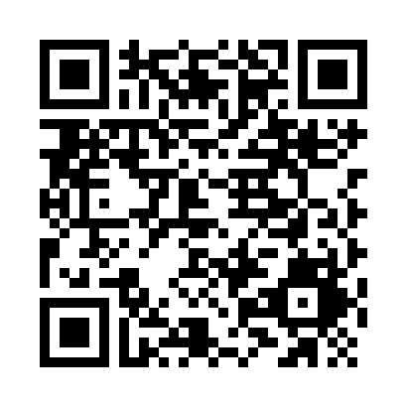
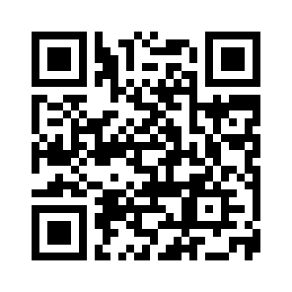
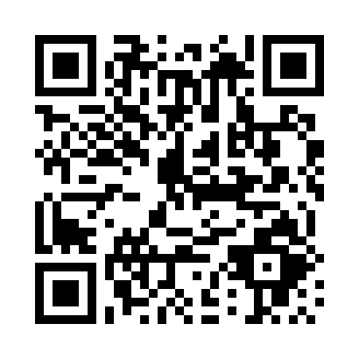

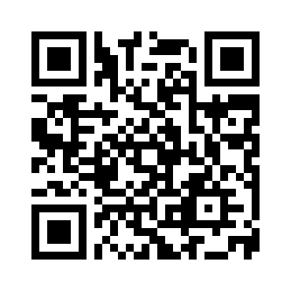
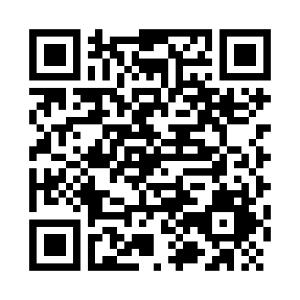
线上聚会链接 QR Codes for Online Meetings
Sunday Service (主日敬拜)
Sunday School (主日学)
Wednesday Prayer (周三祷告会)
North Group (北区团契)
Youth Parents (父母组团契)
Hope Group (盼望小组)

